Slide 2
Act 1. Scene 1

Slide 3
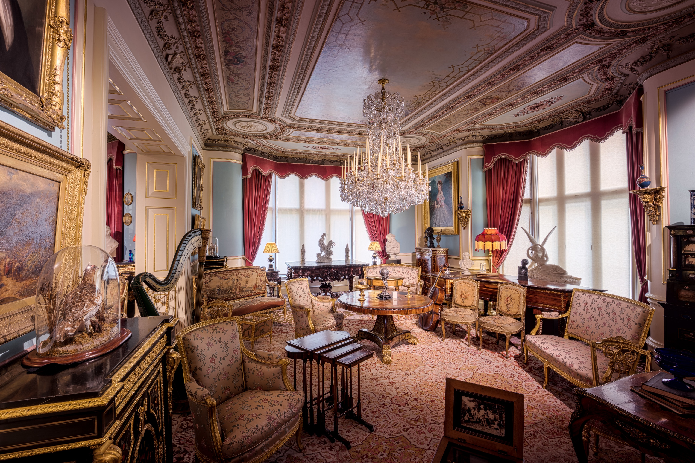
两个老头密谋打赌的场景 找不到合适的☹

Slide 5
Act 1. Scene 2

Slide 6
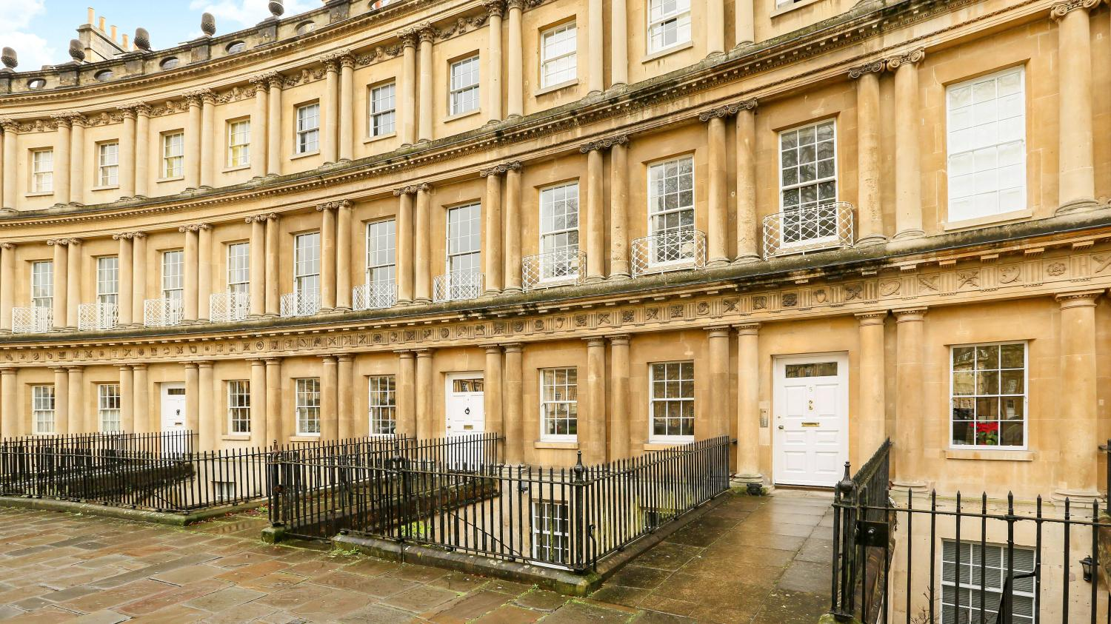

Slide 7


The enclosed Bank Note is lent to you for one month. If you return it intact at the end of that time, you shall have any job that is within our power to give you. It may interest you to know that we have a bet on you.
两个老头密谋打赌的场景 找不到合适的☹

Slide 9
Act 2

Slide 10
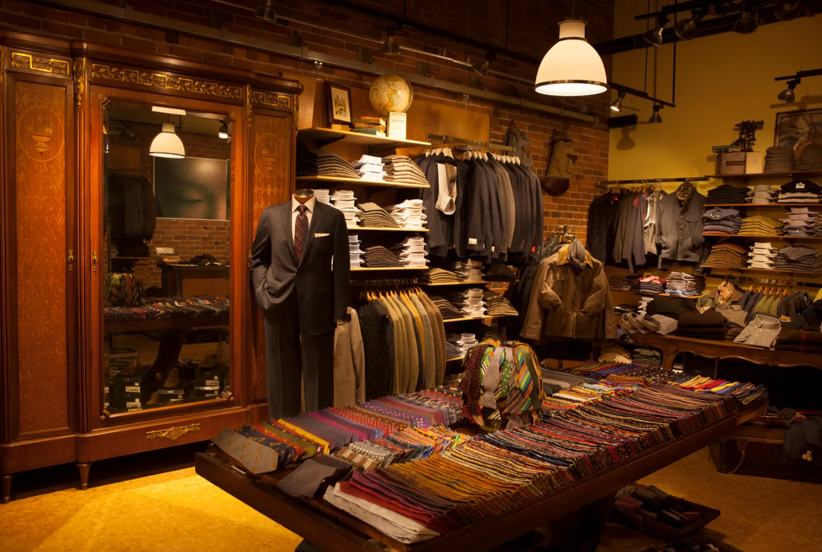

Slide 11
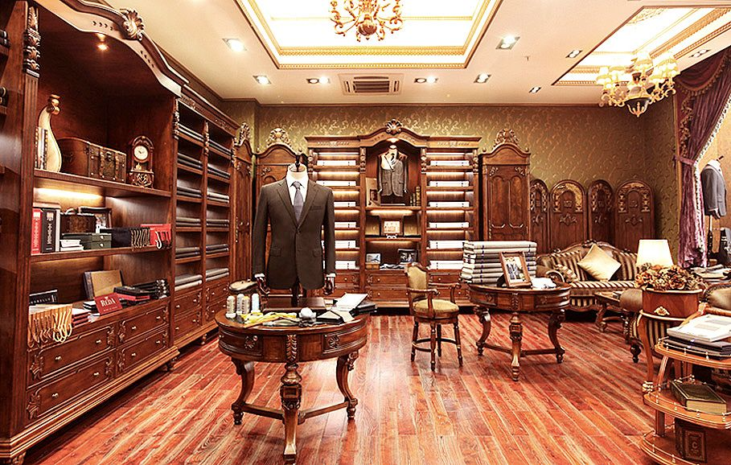

Slide 13
Act 3

Slide 14
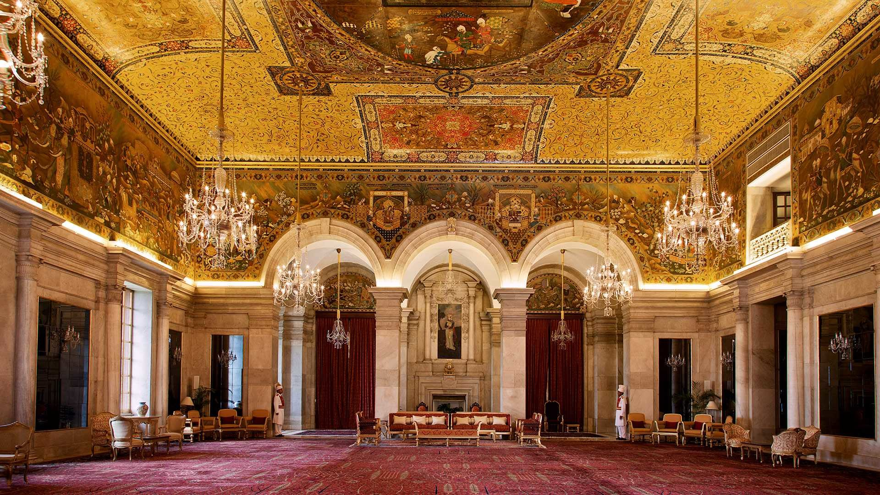

Slide 16
Act 4

Slide 17


Slide 19
Act 5. Scene 1

Slide 20


Slide 21


Slide 23
Act 5. Scene 2

Slide 24
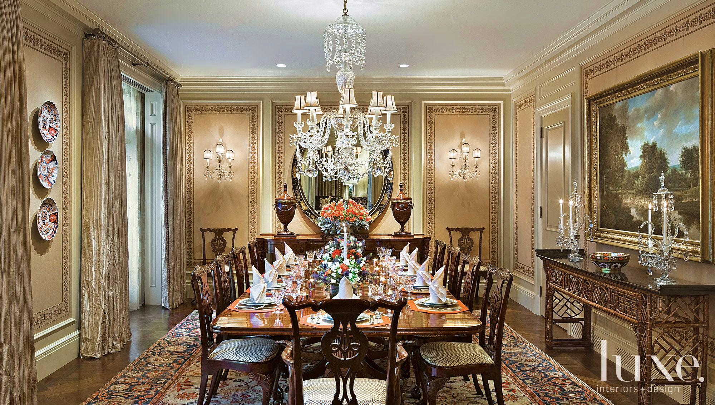

Slide 25


Slide 28
Act 5. Scene 3

Slide 29
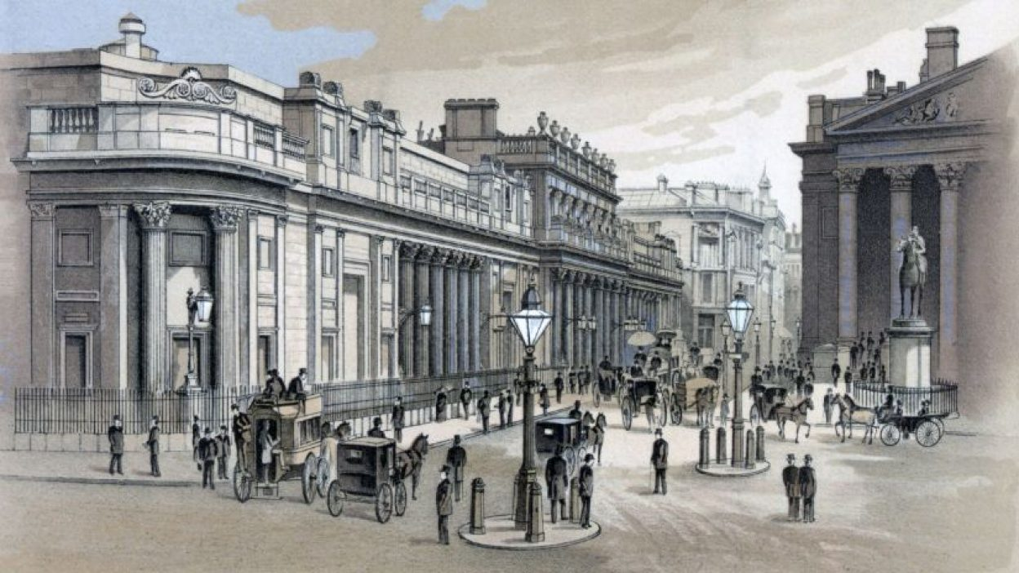
London Stock Exchange

Slide 31
Act 6

Slide 32
两个老头密谋打赌的场景 找不到合适的☹

Slide 33
Shakespeare tells us, money can turn black into white, ugly into beautiful, cowards into warriors. Of course, these tiny scraps of paper can be one of the most economical ways to stimulate ones potentials. But in a society where money is, absurdity will be the ultimate trap. Adulation for the rich, despise of the poor, together with relentlessly magnified greed, make all the people disgustingly hypocritical. Unfortunately, we can't go without money. Yet still, we need to keep in mind: After all, Shakespeare also tells us that, if money can't bring peace and satisfaction, then a rich man is no better off than a poor one. From the bottom of your heart, there is certainly something more worthy of pursuit, like kindness and love. But for his earnestness, Henry wouldn't have won Portia's heart.

Slide 34
Cast
Henry Adams 王奎承
Portia Langham 徐子涵
Lloyd Hastings 李婧涵
Duke of Frognal 许正宁
Narrator 王睿盈
Oliver Montpelier 罗孜涵
Roderick Montpelier 王瑞涵
Mr. Garrat 盛昱皓
Montpelier‘s butler 徐翌轩
Clothes Shop Salesman 1 王 神
Clothes Shop Salesman 2 姜 懿
Clothes Shop Manager 佘俊颖
Bumbles Manager 鲁尤悠
Duchess of Cromarty 王敏茜
Duke of Cromarty 张天祺
Renie 丁菲鋆
Director 王敏茜
Playwright 潘柏桦 王奎承 张天熠
Supervisor 潘柏桦
Property 苏 汇
Background 应宇轩
Presented by 高二(6)班

